Slide 1

Credit Card Default Prediction
LOGAN LIU
MATTHEW PENG
NEHA ANNA JOHN
QINPEI ZOU
VIKRANT VAIDYA

Slide 2
Outline
Introduction
Exploratory Data Analysis
Modeling & Insights
Conclusion

Slide 3
Introduction

Slide 4
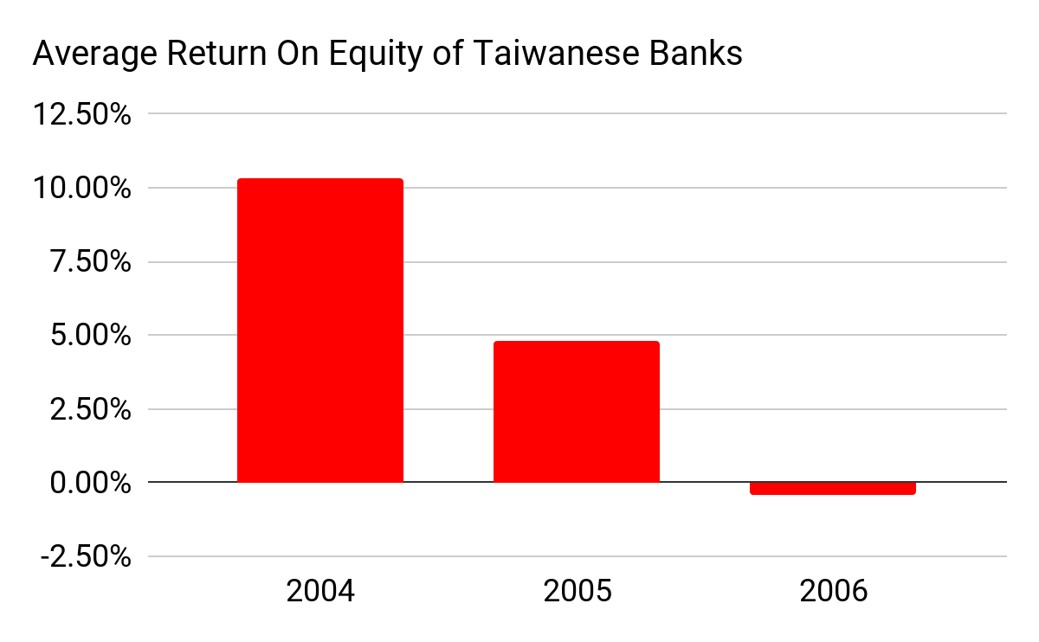
Problem Statement
We are helping a Taiwanese bank to reduce loss caused by credit card payment defaults
Imagine you have
USD 33,000 of credit card bills
that dues next month
Notes:
Background Information
From 2005 to 2006, a Credit Card Crisis happened in Taiwan
In Taiwan, in February 2006, debt from credit cards and cash cards reached $268 billion USD which is twice as much as the annual fiscal budget of Texas state in 2016 ($127.3 billion USD)
2% of adults have difficulties paying their credit card debt, some debtors and their families committed suicide because of the debt, some became homeless due to repossession of their homes
The bad debt caused by credit card payment default ate 30~50% of revenues made by credit card departments
If we can predict which customer is about to default, we could suspend their cards temporarily before the clients making purchases that they won’t able to repay
Texas fiscal budget
https://ballotpedia.org/Texas_state_budget_and_finances
Impact of Credit Card Crisis
https://www.npf.org.tw/2/3558
https://sevenpillarsinstitute.org/case-studies/taiwans-credit-card-crisis/

Slide 5
Exploratory Data Analysis

Slide 6
Key Variables
Predictor variables
ID of each credit card client
Demographic information: Sex, Education, Marriage, Age
Repayment status on credit card bill for 6 months (Apr2005-Sep2005)
Credit card bill statement for 6 months (Apr2005-Sep2005)
Credit card repayment for 6 months (Apr2005-Sep2005)
Output variables
Default payment flag for Oct 2005

Slide 7
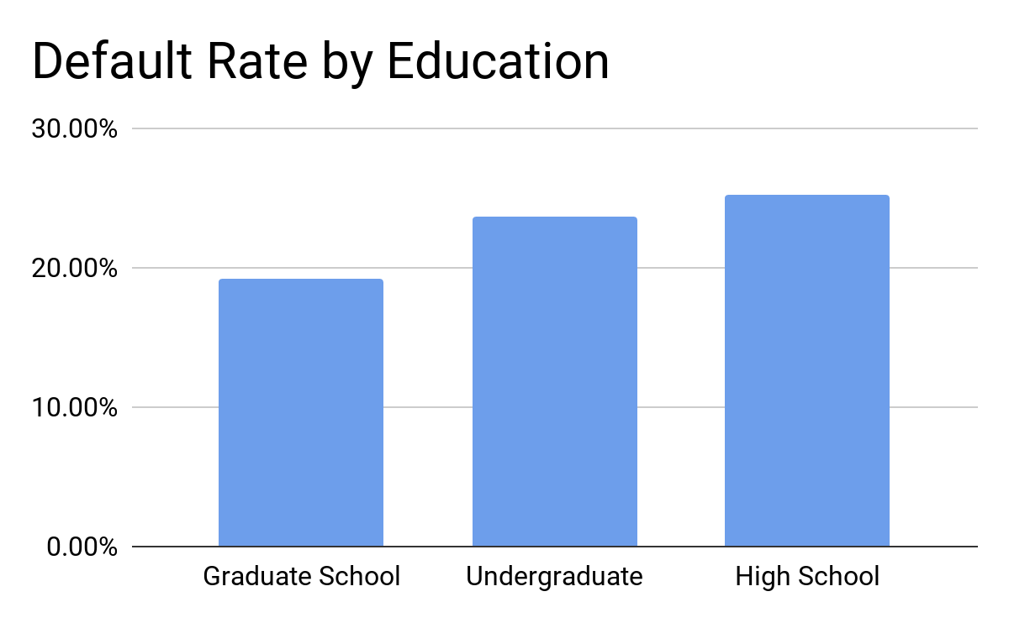
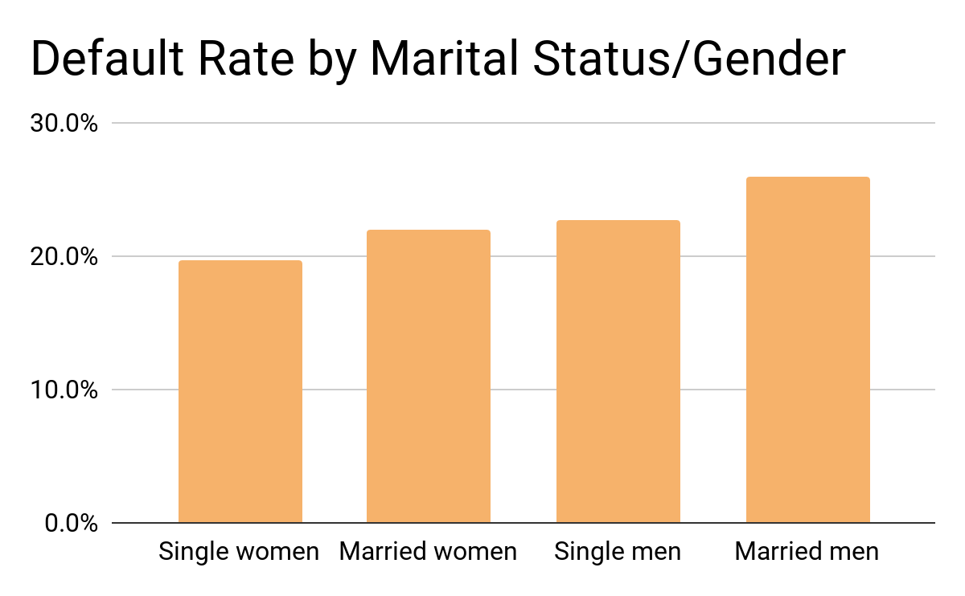
Exploratory Data Analysis
Key findings:

Slide 8
Modeling & Insights

Slide 9
Methodology
Implemented multiple models on training data:
Logistic Regression
KNN Classifier
Decision Tree, Random Forest and Gradient Boosting
Evaluated key metrics for model performance on test data:
Precision-Recall
Misclassification rate
Confusion Matrix

Slide 10
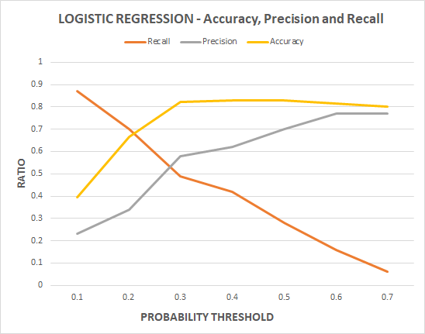
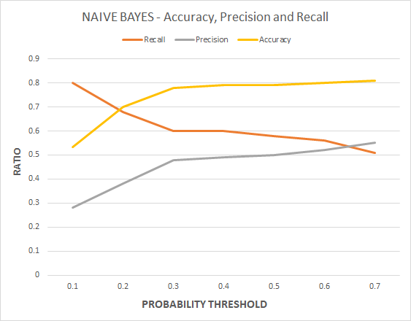
Logistic Regression And Naive Bayes
Used Lasso cross validation for variable selection - LIMIT BAL, SEX, MARRIAGE, PAYMENT_FLAGS, BILL AMT for last month and PAYMENT AMTS for last two months came out to be as the significant variables

Slide 11
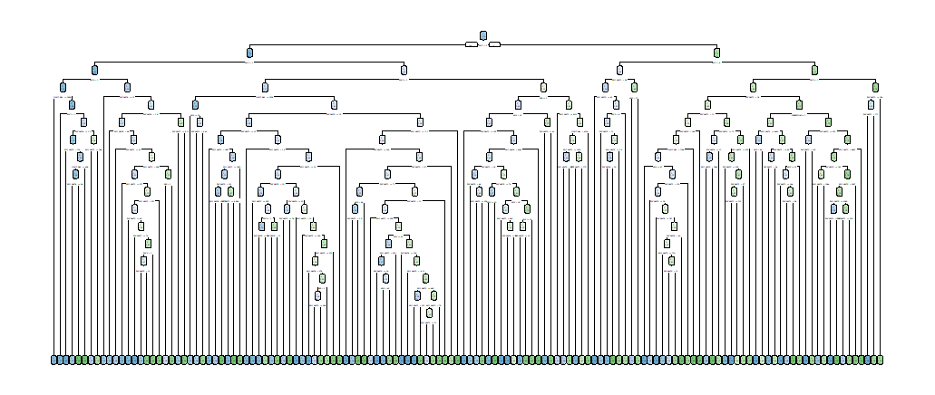
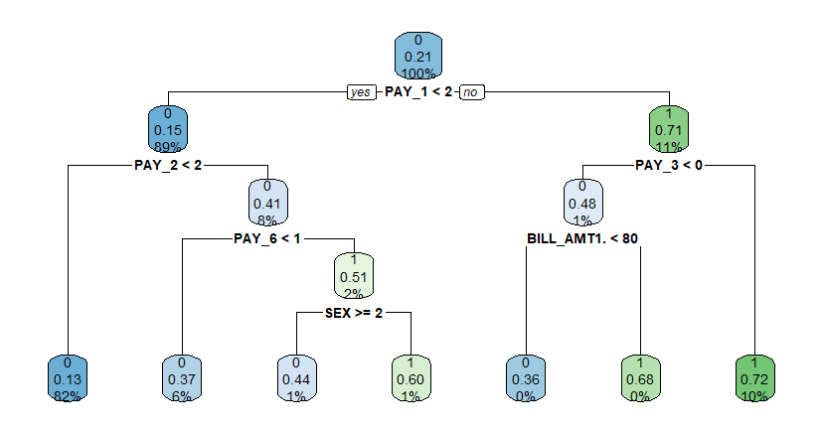
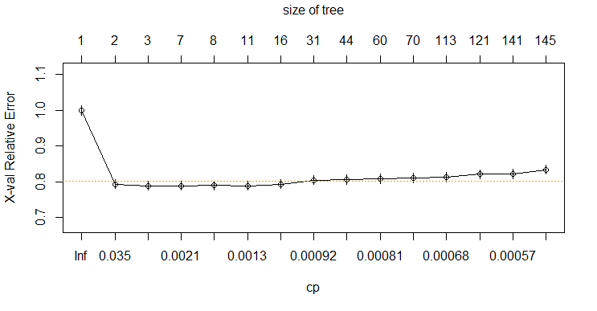

Decision Tree: Analysis & Insights
minsplit = 5

Slide 12
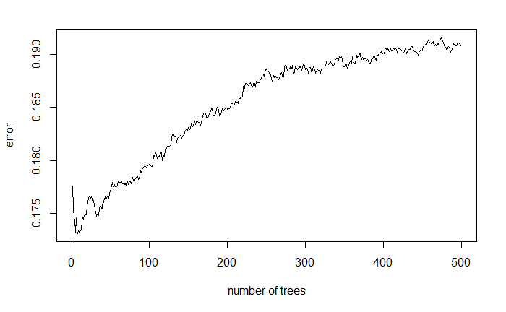
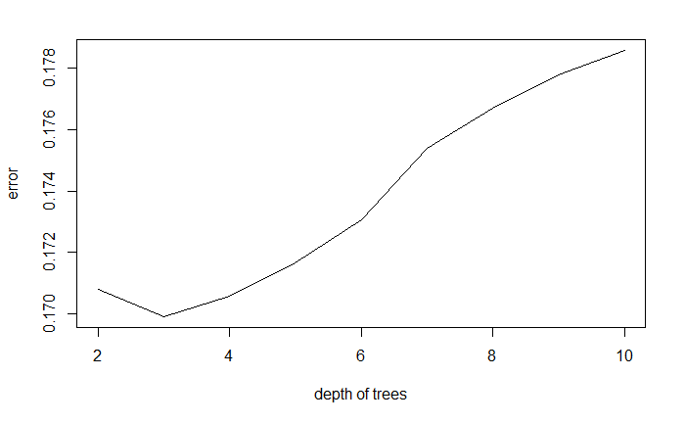
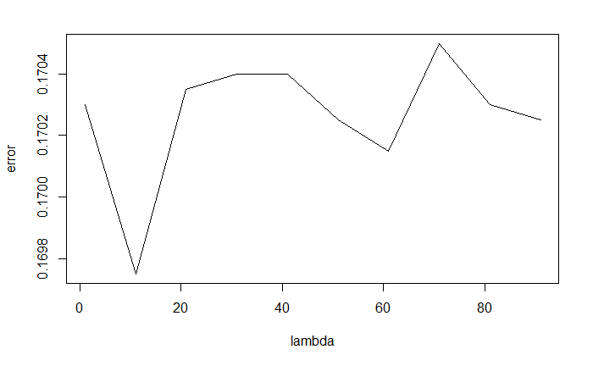
Gradient Boosting: Analysis & Insights
nround: 300 -> 10
depth of tree: 6(default) -> 3
lambda: 1(default) -> 10
Misclassification Rate:
0.180
↓
0.159
or…
eta: 0.3(default) ->0.05
other parameters remain the same
Misclassification Rate:
0.180
↓
0.162
maybe next time we can start with eta?
things to consider:
computing time
too larger -> miss the optimization
too small -> stuck in local optimization

Slide 13
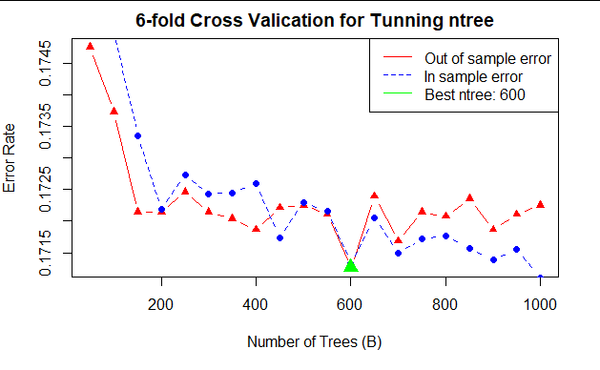
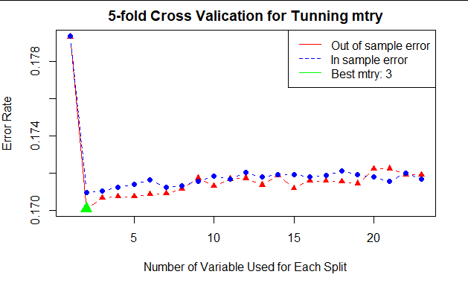
Random Forest: Analysis & Insights
One Predictor provides a lot of information
ntree = 600
variables trying = 3
Pred Actual | Non default(0) | Default(1)
Non- default(0) | 6301 | 1066
Default(1) | 319 | 680
Notes:
After we tried decision tree and boosting gradient, we explored the data with another machine learning technique, which is random forest. As we all learned, number of the trees & variables trying for each split are the two important parameters for Random forest. So I tuned the both parameter by cross validation and use 600 hundred trees and 3 variable for each split to build the best model. What I found interesting in tuning is that the error rate for each number of variables trying are fairly very close

Slide 14
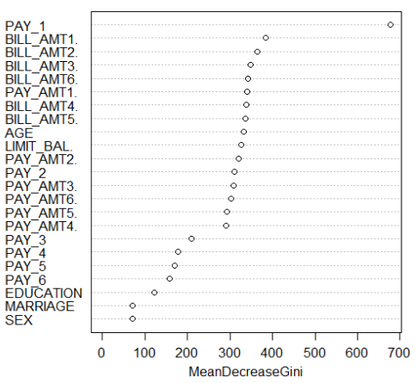
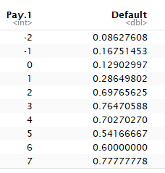
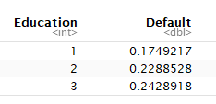
Random Forest: Analysis & Insights
Most of variables contribute similar weights to prediction of default
Error rate doesn’t change much with number of variable trying
many predictors share similar mean decrease Gini
One predictor strong influent prediction of default (Pay 1)
Pay 1 = 5 means the person 1 month ago delay the payment for 5 months
Many variables are redundant information (Pay 3 - Pay6)
(Pay 2 = 4) ∈ (Pay 1 = 5)
Confliction from EDA: Education doesn’t contribute much information
Grad School
College
Hign School
Notes:
By checking the importance of each predictor measured according to decrease Gini score, we found variable pay 1 stands out while most of variables in the middle have similar score.
but in contrast, pay2...pay4 have low importance score. If you deley your payment 5 months today, a month you must had been delayed your payment for 3 month
another interesting thing I found in these low importance group

Slide 15
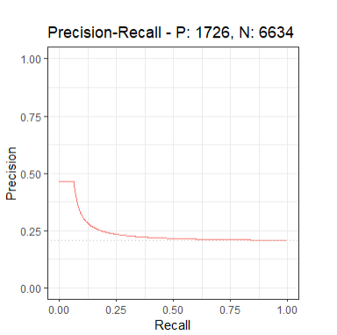
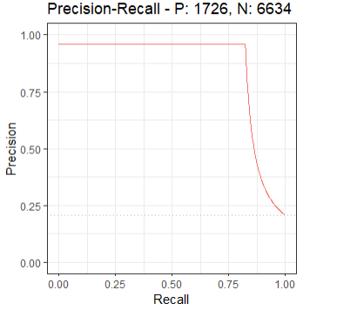
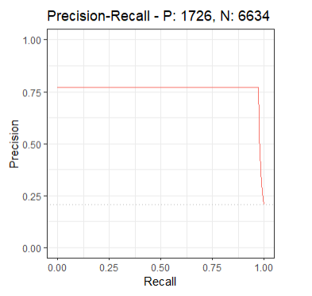
KNN Classifier: Analysis & Insights
KNN without normalization
KNN with normalization
KNN with normalization and SMOTE

Slide 16
KNN Classifier: Analysis & Insights
Normalization of continuous variables highly effective for KNN Classifier:
Reduced misclassification rate by about 15%
More than doubled precision and improved recall significantly
SMOTE technique:
Reduced precision marginally
Produced highest recall across all techniques
More important to correctly identify defaulters vs others-Recall:
SMOTE delivers best on Recall

Slide 17
Conclusion

Slide 18
Output Summary
Model Name | Precision | Recall | Misclassification Rate
Logistic Regression | 0.71 | 0.29 | 0.17
Naive Bayes | 0.50 | 0.58 | 0.21
KNN Classifier with Normalization | 0.95 | 0.82 | 0.043
KNN Classifier with SMOTE | 0.77 | 0.97 | 0.066
Decision Tree | 0.35 | 0.67 | 0.17
Random Forests | 0.39 | 0.64 | 0.17
Gradient Boosting without tuning | 0.594 | 0.407 | 0.180
Gradient Boosting with tuning | 0.695 | 0.406 | 0.159

Slide 19
Recommendations
Leverage Recall as the primary metric for evaluating model performance
KNN Classifier with SMOTE provides best performance and can help predict the maximum number of probable credit defaulters
Next Steps:
Build a stronger model leveraging data from last quarter/shorter period rather than half year

Slide 20
Appendix

Slide 21
KNN Classifier

Slide 22
Findings: K=20,K=50
Metric | Without normalization | With normalization | With SMOTE
Precision | 0.47 | 0.96 | 0.84
Recall | 0.09 | 0.79 | 0.98
Misclassification rate | 21.4 | 3.09 | 4.24
Metric | Without normalization | With normalization | With SMOTE
Precision | 0.46 | 0.95 | 0.77
Recall | 0.06 | 0.82 | 0.97
Misclassification rate | 20.86 | 4.35 | 6.58

Slide 23
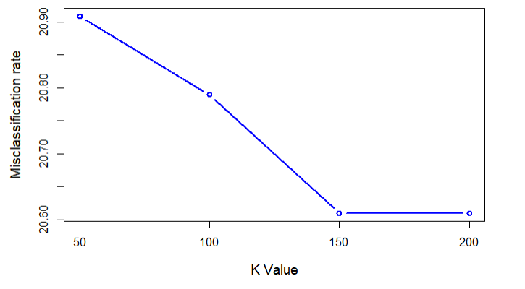
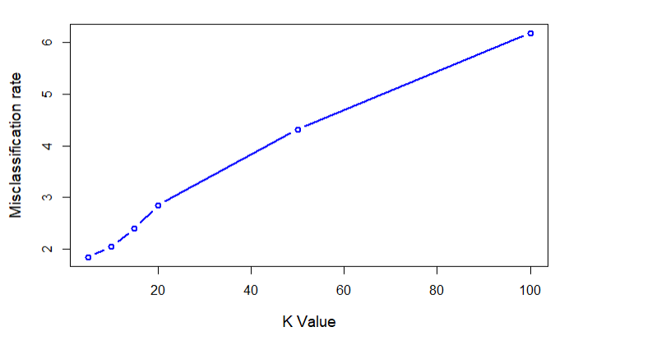
Findings: Best K value
Finding the best K value for KNN with and without normalization
K value 200 with misclassification rate 20.61
K value 5 with misclassification rate 1.84

Slide 24
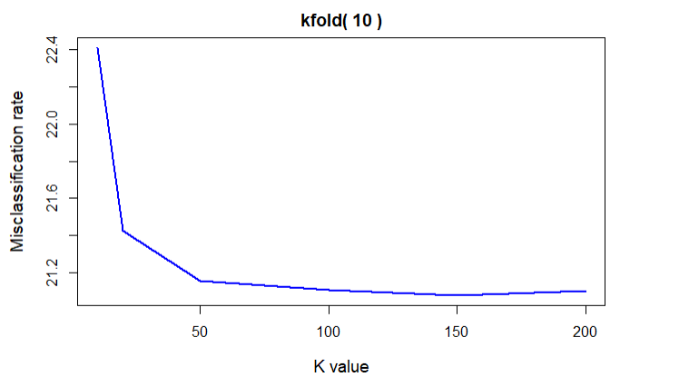
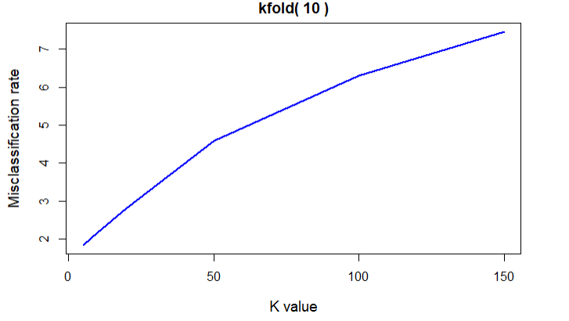
Findings: KCV=10
K fold Cross Validation=10 for data with and without normalization

Slide 25
Gradient Boosting

Slide 26
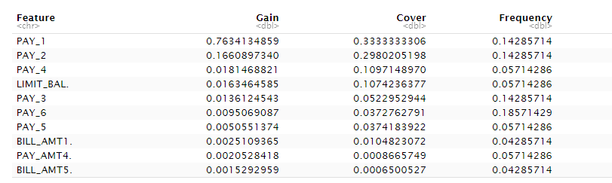
Gradient Boosting: Importance

